Slide 1
Task 3: Ethical Hacking Internship
Mayuresh Atul joshi

Slide 2
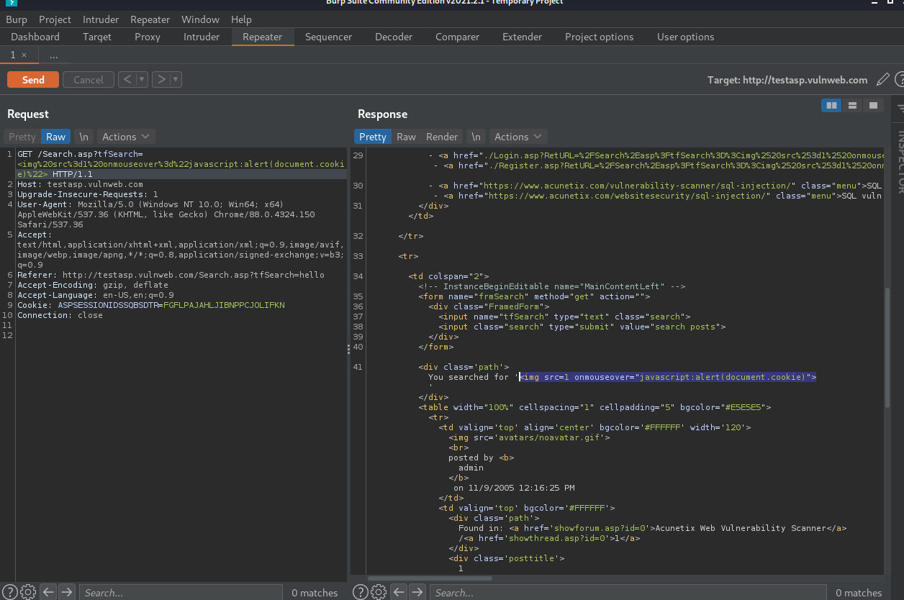
PoC

Slide 3
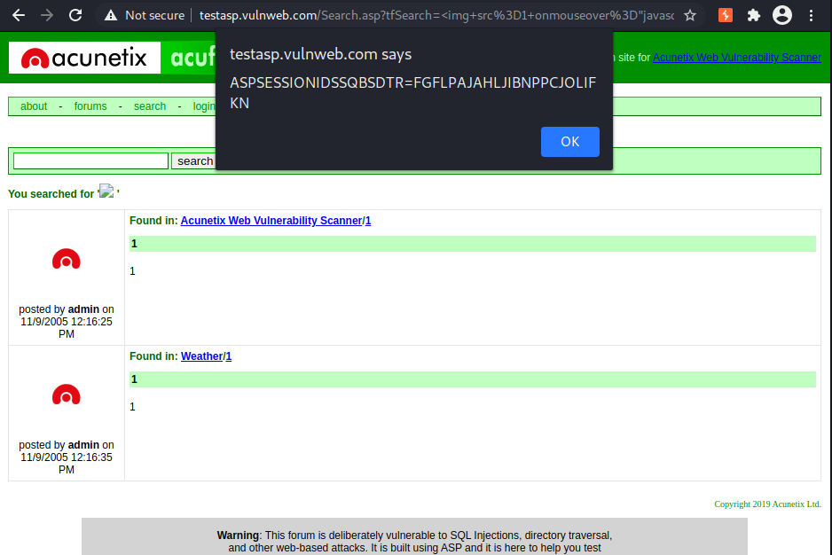
Injection Demo

Slide 4
Report

